Slide 1

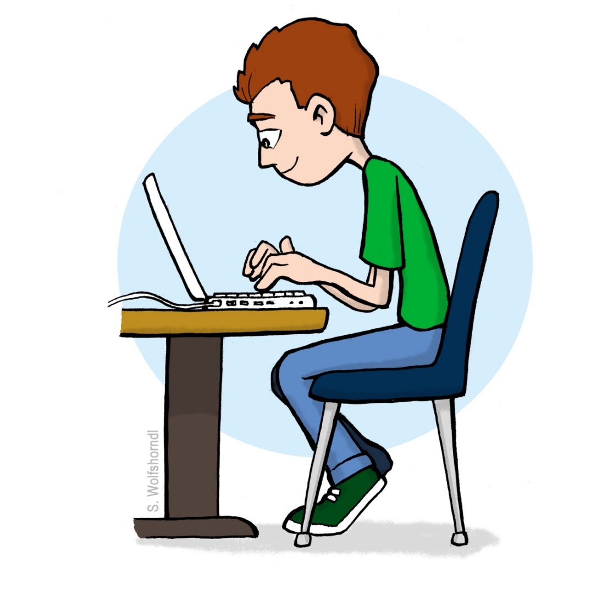
Once you are entered here your success will confirm……

